Slide 1
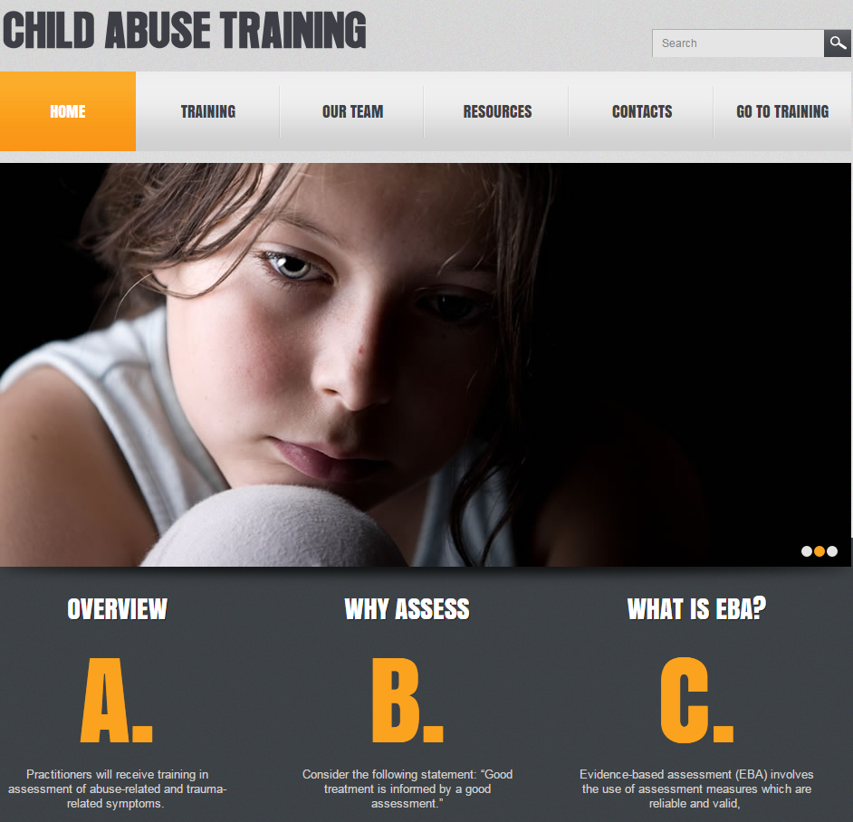
Evidence-Based Treatments for Use in A
CAC Setting: Introduction & Overview
Jeffrey N. Wherry, Ph.D., ABPP
806.470.3342
jeffreynei@aol.com

Slide 2
What is evidence-based treatment?

Slide 3
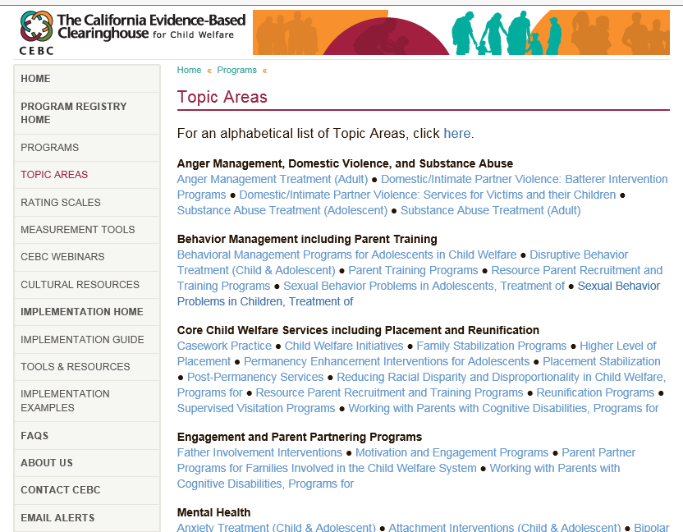
California Evidence-Based Clearinghouse for Child Welfare http://www.cebc4cw.org/search/topic-areas/

Slide 4
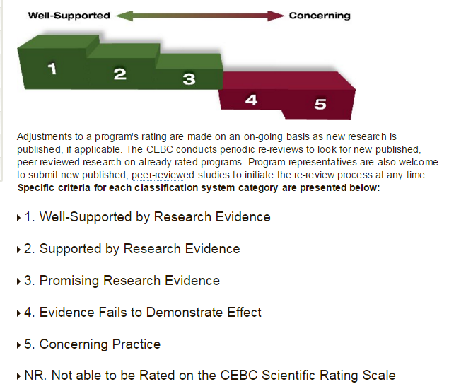
http://www.cebc4cw.org/ratings/scientific-rating-scale/

Slide 5
1--Well-Supported by Research Evidence
1-Multiple Site Replication and Follow-up:
  At least two rigorous randomized controlled trials (RCTs) in different usual care or practice settings have found the practice to be superior to an appropriate comparison practice.
  In at least one of these RCTs, the practice has shown to have a sustained effect at least one year beyond the end of treatment, when compared to a control group.
  The RCTs have been reported in published, peer-reviewed literature.

Slide 6
1--Well-Supported by Research Evidence
Outcome measures must be reliable and valid, and administered consistently and accurately across all subjects.
If multiple outcome studies have been published, the overall weight of the evidence supports the benefit of the practice.
There is no case data suggesting a risk of harm that: a) was probably caused by the treatment and b) the harm was severe or frequent.
There is no legal or empirical basis suggesting that, compared to its likely benefits, the practice constitutes a risk of harm to those receiving it.
The practice has a book, manual, and/or other available writings that specify components of the service and describe how to administer it.

Slide 7

2-Supported by Research Evidence
1--Randomized Controlled Trial and Follow-up:
  At least one (not two) rigorous randomized controlled trial (RCT) in usual care or a practice setting has found the practice to be superior to an appropriate comparison practice.
  In that same RCT, the practice has shown to have a sustained effect of at least six months (not one year) beyond the end of treatment, when compared to a control group.
  That same RCT has been reported in published, peer-reviewed literature.
Plus the same

Slide 8
3. Promising Research Evidence
  At least one study utilizing some form of control (e.g., untreated group, placebo group, matched wait list study) has established the practice's benefit over the control, or found it to be comparable to a practice rated a 1, 2, or 3 on this rating scale or superior to an appropriate comparison practice.
  The study has been reported in published, peer-reviewed literature.

Slide 9
4. Evidence Fails to Demonstrate Effect
Doesn’t work based on the weight of the evidence

Slide 10
5-Concerning Practice
Negative Impact or harm

Slide 11
NR. Not able to be Rated on the CEBC Scientific Rating Scale
The practice does not have any published, peer-reviewed study utilizing some form of control (e.g., untreated group, placebo group, matched wait list study) that has established the practice's benefit over the placebo, or found it to be comparable to or better than an appropriate comparison practice.
The practice is generally accepted in clinical practice as appropriate for use with children receiving services from child welfare or related systems and their parents/caregivers.
The practice does not meet criteria for any other level on the CEBC Scientific Rating Scale.

Slide 12

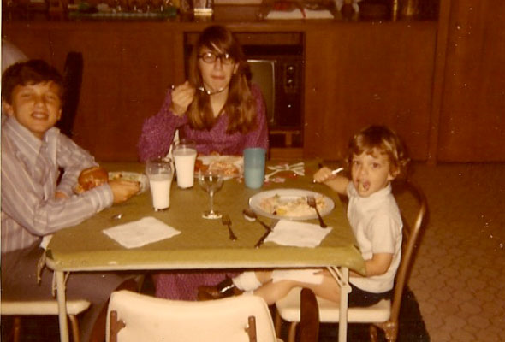
Eat at the adult table if……
With data
Without data

Slide 13
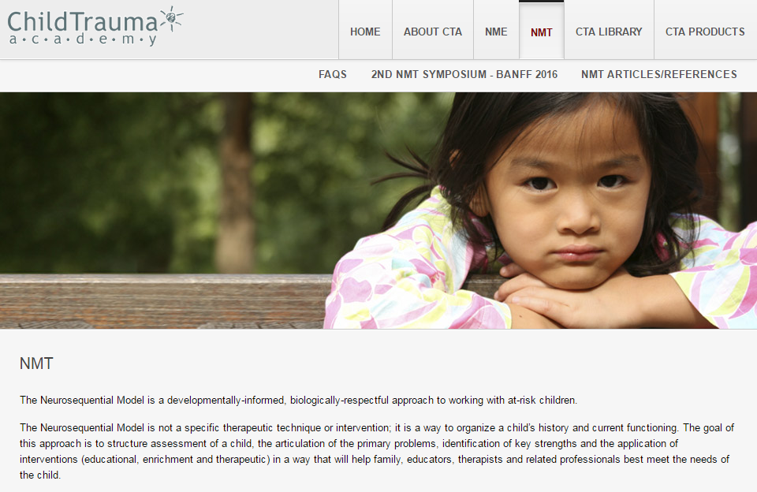
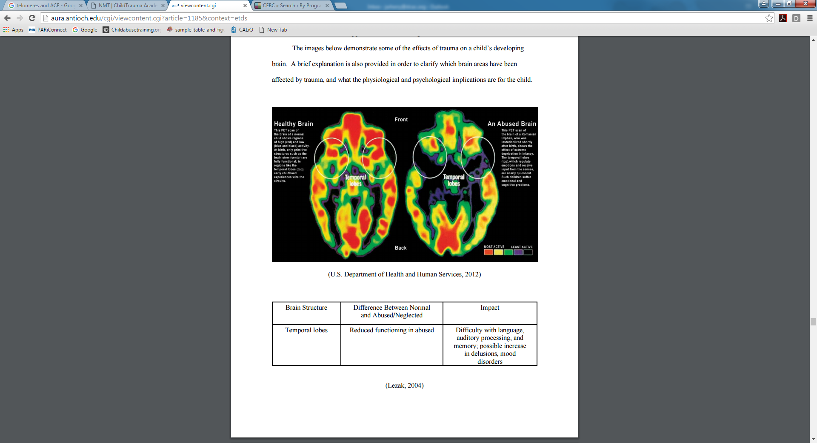
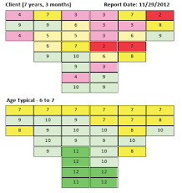
Example: Not on the list and no published relationship between mapping and imaging

Slide 14
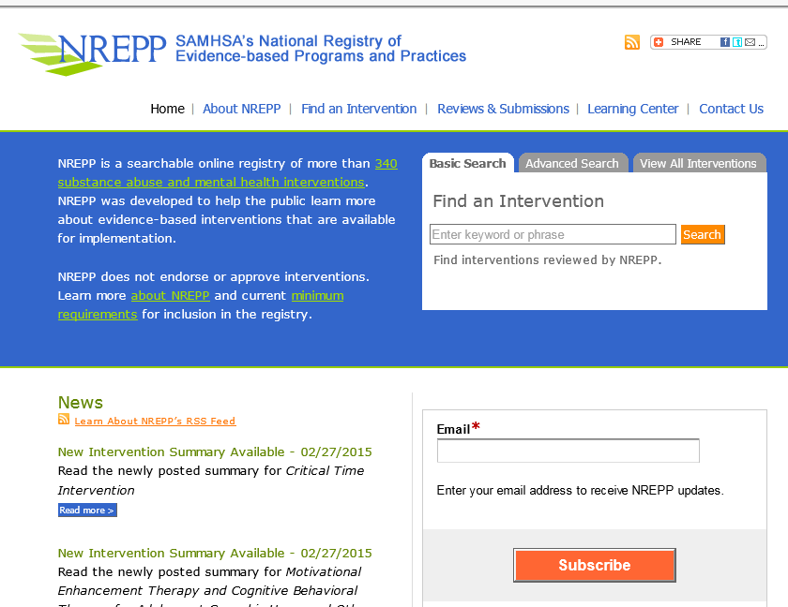
National Registry of Evidence-based Programs and Practices http://nrepp.samhsa.gov/

Slide 15
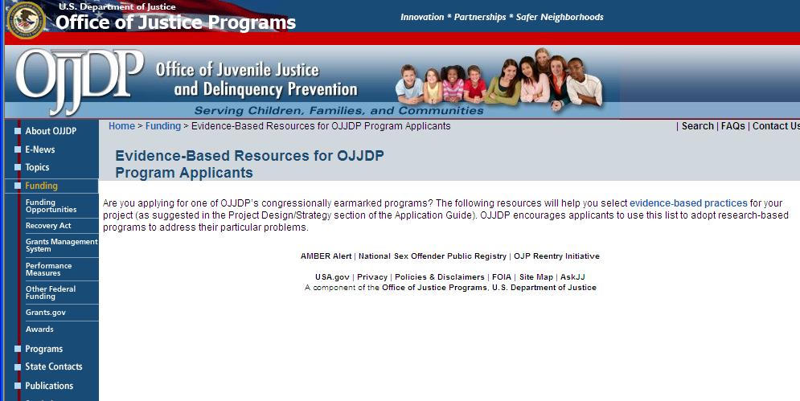
Evidence-Based Resources for OJJDP http://ojjdp.ncjrs.gov/funding/evidencebasedresearch.html

Slide 16
Symptoms of Abuse: Differential Diagnosis

Slide 17

The Conceptual Model

Slide 18
A History of Conceptualization
ABUSE
SYMPTOMS

Slide 19
A History of Conceptualization
DURATION
FREQUENCY
SYMPTOMS
RELATIONSHIP
TYPE OF ABUSE
Knowing these facts accounts for a relatively small percentage of the variance in outcome and symptomatology.

Slide 20
Spaccarelli (1994)

Slide 21
Support Services
The support of the child by a significant adult who conveys an attitude of belief is central to safety and recovery
For parents to be supportive, someone must also support them
  Spouse/Partner
  Parents
  Friends
  NOT their children
Would you believe
an allegation against
your spouse?

Slide 22
Spaccarelli (1994)

Slide 23
BIOLOGY of Trauma

Slide 24
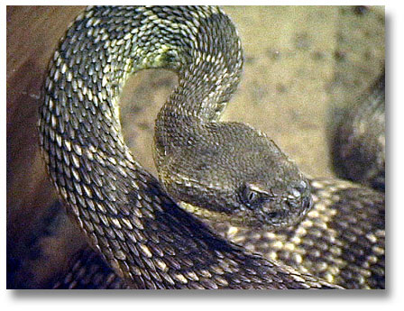
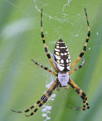
Biology
Freeze
FLIGHT
FIGHT
Alarm

Slide 25
Alarm Reaction(PTSD)
Increase in sympathetic nervous system
↑Heart rate
↑Blood Pressure
↑Respiration
↑Released of stored sugar
↑Muscle Tone
↑Hypervigilance
↑Tuning out non-critical information

Slide 26
Stress Response (Dissociation)
Decreased blood pressure
Decreased heart rate
Endogenous opioids

Slide 27
Arousal + Dissociation
Arousal/PTSD
Dissociation

Slide 28
Conceptual Trauma Model

Slide 29

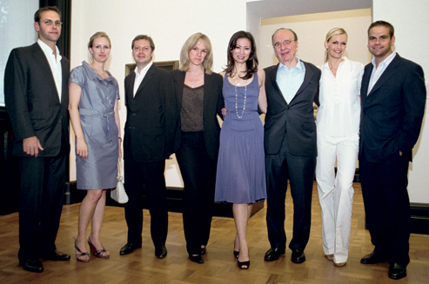
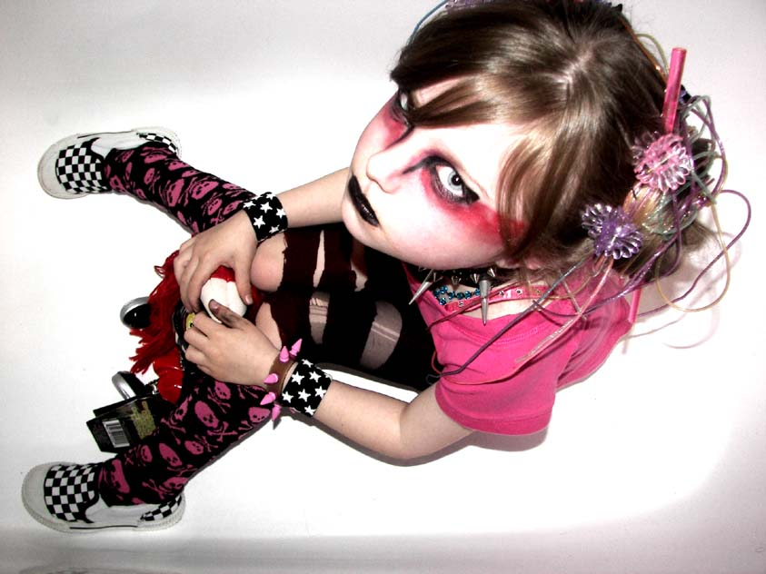
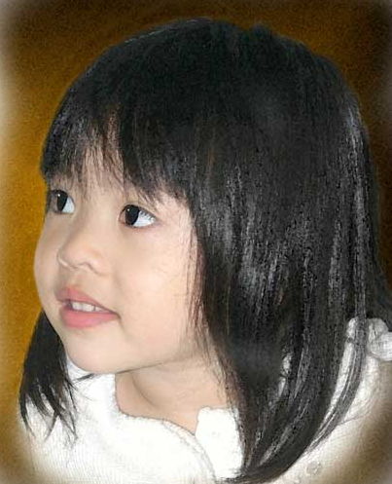
With the Realization That
Diverse family backgrounds among abused children--even those abused by someone outside the family

Slide 30
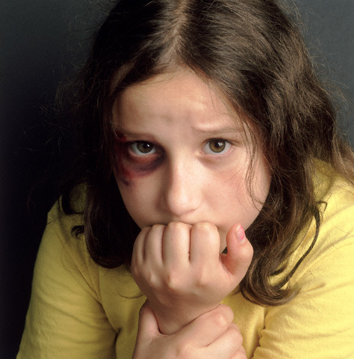
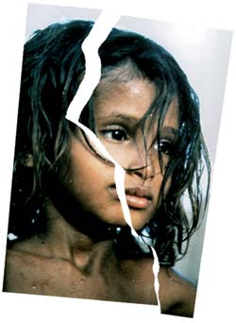
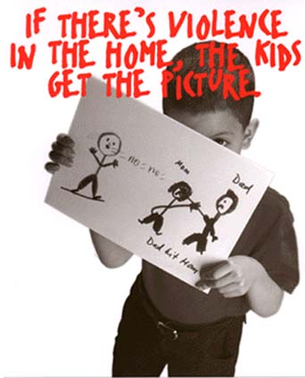
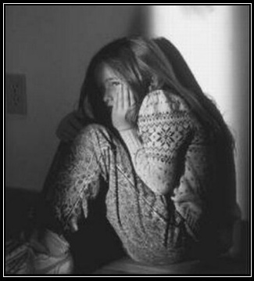
With the Realization That
Diverse abuse or trauma backgrounds

Slide 31
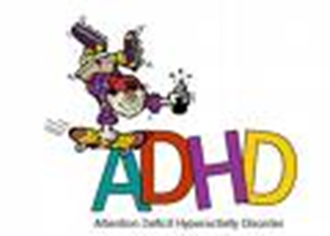

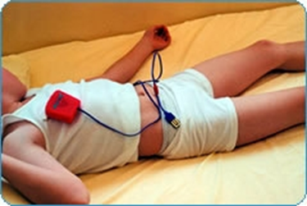
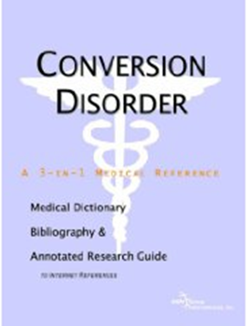
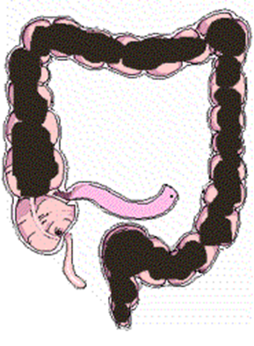
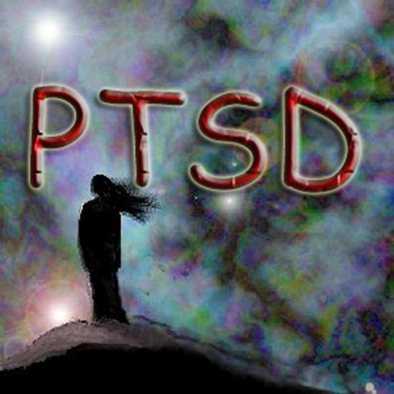
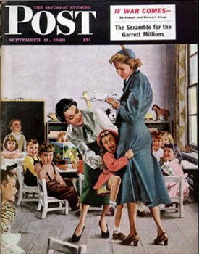
Recognition—Diverse Responses

Slide 32
Signs and Symptoms
Physical/Medical Indicators
  Enuresis
  Encopresis
  Abdominal pain
  Sexually transmitted diseases
  Recurring urinary tract infections
  Recurrent vaginal infections
  Conversion disorder or somatic complaints

Slide 33
Signs and Symptoms
Behavioral Indications
  Self-destructive/Suicidal behavior (34%)
  Sleep/Bedtime difficulties
  Sexual acting out—especially in preschool and adolescent children
  Fire setting
  Running away
  Concentration
  Eating disorders among adolescents
  Substance abuse
  Anger

Slide 34
Typical Reactions
Trauma
Sexualized response
Behavioral problems and negative affectivity

Slide 35
Abuse Reactions
Trauma
PTSD
Dissociation
Sexualized response
Behavioral problems and negative affectivity
Anxiety
Depression
Anger

Slide 36
PTSD Criteria
Arousal (2) Re-Experiencing (1) Avoidant (3)
Sleep Recollections Thoughts/Feelings
Irritability Dreams Activities
Concentration Seems to Recur Memories
Hypervigilance Symbols Interests
Startle Others
Physiologic Affect
Future

Slide 37
PTSD Criteria—Proposed DSM-V
Arousal (2) Re-Experiencing (1) Avoidant (1)
Sleep Recollections Thoughts/Feelings
Irritability Dreams Activities (External)
Concentration Dissociative Cognitions/Moods(3/2)
flashbacks Dissociative amnesia
Hypervigilance Distress to symbolic Negative self-expectations
Startle Physiologic Self-blame
Reckless or Pervasive horror, fear
self-destructive Interests
Detachment/Others
Restricted Affect
Future
See the work of Scheeringa,
Zeanah, & Cohen, 2010

Slide 40
DSM-IV Criteria for PTSD by DICA Parent Report*
Category Percent
Arousal 89%
Re-experiencing 84%
Avoidance 53%
Full Diagnosis 47%
*Pollio (2002): 57 sexually abused children

Slide 41
PTSD Over Time
TRAUMA
SUPPORT (+)
PERCEIVED THREAT (-)
SYMPTOMS
AROUSAL RE-EXPERIENCING AVOIDANT
IMMEDIATE
DAYS OR MONTHS
MONTHS or YEARS

Slide 42
Misdiagnosis and Co-morbidty:
A PTSD Formulation for Children
  AROUSAL
  RE-EXPERIENCING
  AVOIDANCE
PANIC/PHOBIA
ADHD
BIPOLAR
HALLUCINATIONS
SUBSTANCE ABUSE
DISSOCIATION
CONDUCT DISORDER
OPPOSITIONAL
PHOBIA
CONVERSION
SOMATIC
SEPARATION
ANXIETY/
OVERANXIOUS

Slide 43
What symptoms are we treating?

Slide 44
Abuse Reactions
Trauma
PTSD
Dissociation
Sexualized response
Behavioral problems and negative affectivity
Anxiety
Depression
Anger

Slide 45
Evidence-Based
Treatments

Slide 47
Typical Problems in Intervention
Engagement
Compliance
Dropout (36%)
Missed Appointments
  38% no show at home
  66% clinic no-show rate
Re-abuse (23%) during treatment
Recidivism (30-47%)

Slide 48
TF-CBT
Core components for use
Provided in a flexible, developmentally appropriate manner
Designed for short-term use (as few as 12 sessions) though it can be used for longer periods of time
Research indicates that TF-CBT is effective in treating
  Posttraumatic stress disorder (PTSD),
  Depression, and
  Behavioral problems (including sexual behavior problems) in children exposed to traumatic events.

Slide 49
Trauma-Focused Cognitive Behavioral Therapy Core Components
PSYCHOEDUCATION: Providing education to children and their caregivers about the impact of trauma on children and common childhood reactions to trauma
STRESS MANAGEMENT: Developing personalized stress management skills for children and parents
AFFECTIVE EXPRESSION & MODULATION: Helping children and parents identify and cope with a range of emotions
COGNITIVE COPING: Teaching children and parents how to recognize the connections between thoughts, feelings and behaviors

Slide 50
Trauma-Focused Cognitive Behavioral Therapy Core Components
CREATING THE TRAUMA NARRATIVE: Encouraging children to share their traumatic experiences either verbally, in the form of a written narrative, or in some other developmentally appropriate manner.
COGNITIVE PROCESSING: Modifying children's and parents' inaccurate or unhelpful trauma-related thoughts, and
BEHAVIOR MANAGEMENT TRAINING: Helping parents develop skills for optimizing their children's emotional and behavioral adjustment
PARENT CHILD SESSIONS: Helping children and parents talk with each other about the traumatic experiences

Slide 51
TFCBT PPRACTCICE
Psychoeducation
Parenting
Relaxation
Affective Modulation
Cognitive Coping
Trauma Narrative
Cognitive Processing
In-vivo exposure (reduce avoidance by separating harmless triggers from fear)
Conjoint Sessions
Enhancing Safety
Always gradual exposure
Assessment
Engagement (even MI)
https://depts.washington.edu/hcsats/PDF/TF-%20CBT/pages/Theoretical%20Perspective/TF-CBT%20Components,%20Rationale,%20&%20Methods%20Worksheet.pdf

Slide 52
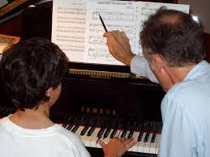
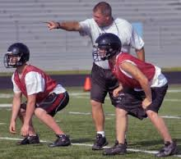
Problems with classes?
Motivation!
Teaching v. Coaching

Slide 53


Behavioral Parent Training
Parents
  Parenting Programs
    Carolyn Webster-Stratton's Incredible Years program (http://www.incredibleyears.com/)
    Matt Sanders' PPP (http://www.pfsc.uq.edu.au/02_ppp/ppp.html)
  PCIT—Coaching parent with child

Slide 54
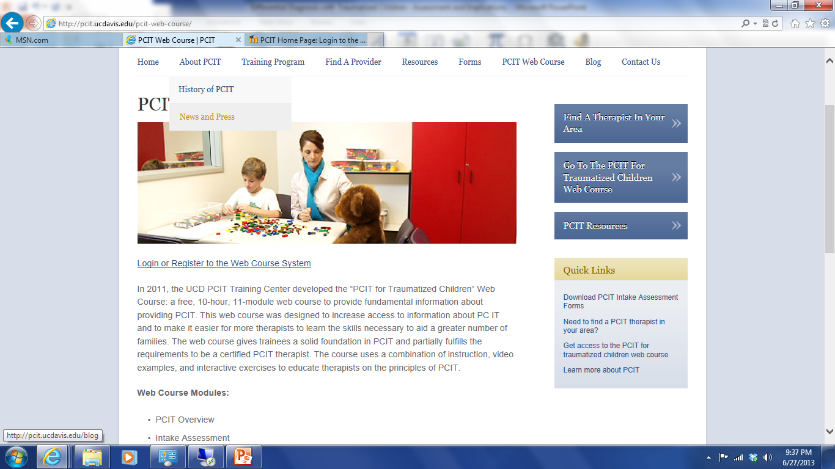
Parent Child Interaction Therapy http://pcit.ucdavis.edu/pcit-web-course/

Slide 55

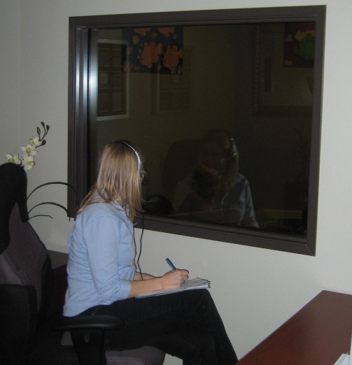
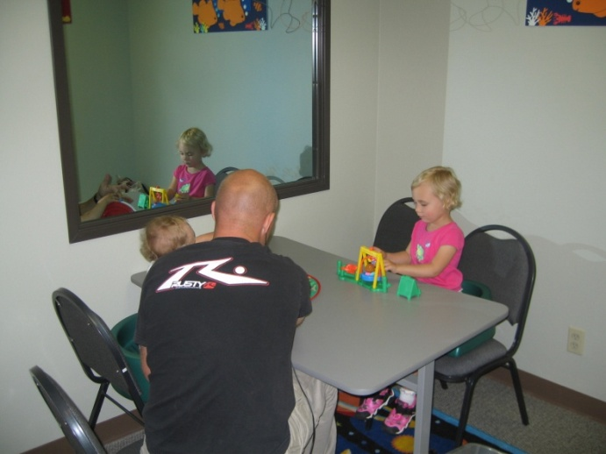
PCIT
Seek to restructure interaction patterns between the parent and child
The therapist intervenes based on direct observations
Parent errors are corrected immediately (COACHING)

Slide 56
PCIT—Web Modules
PCIT Overview
Intake Assessment
Dyadic Parent-Child Interaction Coding System
CDI Teaching Session
  Relationship-building Skills: Praise, Reflection, Imitation, Description, and Enthusiasm
  (PRIDE)
Coaching CDI Skills
PDI Teaching Session
Coaching PDI Skills
Addressing Parenting Styles
Cultural Considerations in PCIT

Slide 57
Child-Directed Interaction
DO
  Praise
  Reflect
  Imitate
  Describe
  Enthusiasm
DON’T
  Give Commands
  Ask Questions
  Criticize

Slide 58
Parent-Directed Interaction
Direct (telling, not asking)
Positive (what to DO, not stop doing)
Single (one at a time)
Specific (not vague)
Age-appropriate
Given in a normal tone of voice
Polite and respectful (Please... )
Explained before given or after obeyed

Slide 59
Other Trauma Treatments
Eye Movement Desensitization and Reprocessing (EMDR) (ages 2-17) Rating of 1
Child-Parent Psychotherapy (CPP) (ages 0-5) Rating of 2
Child and Family Traumatic Stress Intervention (CFTSI) (ages 7-18) Rating of 3
Physical Abuse
  Alternatives for Families: A Cognitive-Behavioral Therapy (AF-CBT) (children ages 6-15 + families) Rating of 3

Slide 60
Alternatives for Families: A Cognitive-Behavioral Therapy (AF-CBT)

Slide 61
Alternatives for Families: A Cognitive Behavioral Therapy (AF-CBT)
Educate about the Cognitive Behavioral Therapy (CBT) model and physical abuse.
Establish agreement with family to refrain from using physical force
Review the child's exposure to emotional abuse in the family and provide education about the, causes, characteristics and consequences of abusive experiences

Slide 62
Alternatives for Families: A Cognitive Behavioral Therapy (AF-CBT)
Identify and address cognitive contributors to abusive behavior in caregivers (i.e., misattributions, high expectations, etc.) and/or their consequences in children (i.e., views supportive of aggression, self-blame, etc.) that could maintain any physically abusive or aggressive behavior.

Slide 63
Alternatives for Families: A Cognitive Behavioral Therapy (AF-CBT)
Teach affect management skills.
Teach parents behavioral strategies to reinforce and punish behavior
Teach pro-social communication and problem-solving skills to the family

Slide 64
Sexualized Behavior

Slide 65
Child Sexualized Behavior
Children with Sexual Behavior Problems Cognitive-Behavioral Treatment Program: School-Age Group
  Contact Information
    Name: Jane F. Silovsky, PhD
    Agency/Affiliation: University of Oklahoma Health Sciences Center
    Website: www.oumedicine.com/body.cfm?id=1532
    Email: jane-silovsky@ouhsc.edu
    Phone: (405) 271-8858
CEBC for CW
www.cebc4cw.org

Slide 66
Children with Sexual Behavior Problems Cognitive-Behavioral Treatment Program: School-Age Group
Family-oriented, cognitive-behavioral, psycho-educational, and supportive treatment group designed to reduce or eliminate incidents of sexual behavior problems
The children
  acknowledge the previous breaking of sexual behavior rules,
  learn coping and self-control strategies, and develop a plan of how they were going to keep these rules in the future.
Caregivers were taught how to supervise the children, teach and implement rules in the home, communicate about sex education, and reduce behavior problems utilizing behavior parent training strategies.

Slide 67
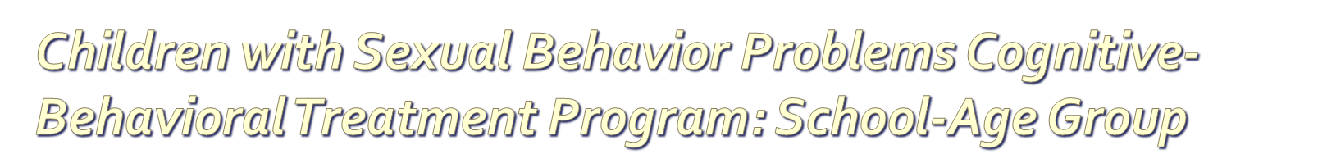
Target Population: Boys and girls age 6-12 with parents
Goals:
  Eliminate or reduce problematic sexual behavior
  Improve child behavior via better parental monitoring, supervision, and behavior management skills
  Improve parent-child interaction and communication
  Improve coping, self-control, and social skills

Slide 68
Adolescent Sexualized
Multisystemic Therapy for Youth with Problem Sexual Behaviors (MST-PSB)
Contact Information
  Name: Richard J. Munschy, PsyD
  Agency/Affiliation: MST Associates
  Website: www.mstpsb.com
  Email: Munschy@mstpsb.com
  Phone: (860) 348-1938

Slide 69
Multi-systemic Therapy for Youth with Problem Sexual Behaviors (MST-PSB)
Treatment incorporates
  intensive family therapy,
  parent training,
  cognitive-behavioral therapy,
  skills building,
  school and other community system interventions,
Ensuring client, victim, and community safety is a paramount mission of the model.

Slide 70
Actual Mismanaged* Case
Medication?
Adderal 20 mg po q am
Depakote 500 mg po q hs
Seroquel 200 mg po bid
DDAVP 0.4 mg po at hs
Ducosate sodium 100 mg po bid
Berocca plus 1 tab po q am
Zoloft 50 mg po q am
Imipramine 25 mg po hs
Clindamycin solution to face bid
Trazadone 100 mg hs
Ortho Novum 777 1 tab q am
Tenex 2 mg po bid
Dexedrine 10 mg po q 4 pm
Zyprexa 15 mg po hs
Topiramate 200 mg q am
Inderall La 80 mg po q am
Detrol 4 mg po bid
Bromocryptine 2.5 mg od

Slide 71
Possibly Innovative versus Risky Treatments
  Eye Movement Desensitization and Reprocessing (EMDR)
  Rebirthing Therapy
  Trauma-Focused Cognitive-Behavioral Therapy (TF-CBT)
  Interpretive Play Therapy
  Thought Field Therapy
  Past-life regression therapy
  Neuro-Linguistic Programming
  Music
  Movement
  Yoga (breathing)
  Drumming
  Therapeutic massage
  Neurosequential Model of Therapeutics

Slide 72
Possibly Innovative versus Risky Treatments
  Eye Movement Desensitization and Reprocessing (EMDR)
  Rebirthing Therapy
  Trauma-Focused Cognitive-Behavioral Therapy (TF-CBT)
  Interpretive Play Therapy
  Thought Field Therapy
  Past-life regression therapy
  Neuro-Linguistic Programming
  Music
  Movement
  Yoga (breathing)
  Drumming
  Therapeutic massage
  Neurosequential Model of Therapeutics
Dismantling Studies

Slide 73
Questionable Therapies for Abuse
No data or poor outcomes
Equine-assisted therapy
Many forms of play therapy
Nondirective therapies (e.g., psychoanalysis, client-centered therapy)
Detrimental
Rebirthing therapy (10-year-old Candace Newmaker)
Attachment therapy
Holding therapy
Over medication
NMT
TBRI

Slide 74
Components

Slide 75
TF-CBT- Core Components
PSYCHOEDUCATION: Providing education to children and their caregivers about the impact of trauma on children and common childhood reactions to trauma
STRESS MANAGEMENT: Developing personalized stress management skills for children and parents
AFFECTIVE EXPRESSION & MODULATION: Helping children and parents identify and cope with a range of emotions
COGNITIVE COPING: Teaching children and parents how to recognize the connections between thoughts, feelings and behaviors

Slide 76
TF-CBT Core Components (Continued)
CREATING THE TRAUMA NARRATIVE: Encouraging children to share their traumatic experiences either verbally, in the form of a written narrative, or in some other developmentally appropriate manner.
COGNITIVE PROCESSING: Modifying children's and parents' inaccurate or unhelpful trauma-related thoughts, and
BEHAVIOR MANAGEMENT TRAINING: Helping parents develop skills for optimizing their children's emotional and behavioral adjustment
PARENT CHILD SESSIONS: Helping children and parents talk with each other about the traumatic experiences

Slide 77
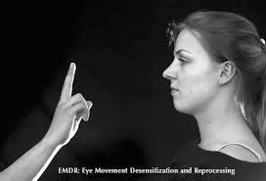
Eye Movement
Desensitization & Reprocessing
Stress Management
Assessment and establishing a therapeutic relationship
Preparation Phase—self-soothing for emotional distress
Identifying disturbing event and negative cognition
After accessing stored memories--use “Adaptive Information Processing”—desensitization
Replace with a more preferred or adaptive thought
Use of self-soothing and calming skills
Evaluation of progress
Exposure
Cognitive Processing
Stress Management

Slide 78
Prolonged Exposure
Psychoeducation
Provide rationale for treatment
Create in vivo exposure hierarchy with triggers
Conduct imaginal exposure
Deliver psychoeducation regarding common reactions to trauma
Teaching breathing retraining exercises that will help the patient to feel calm
Exposure
Psychoeducation
Stress Management

Slide 79
Child-Parent Psychotherapy (ages 0-5)
Parent Training
(Focus on the parent-child dyad)
Promote safety (behavior, limits, parent-child roles)
Affect regulation
  Psychoeducation for parents regarding developmental expectations (aka cognitive)
  Label & support affective experiences
  Encourage soothing & helpful responses of parents to “upsetness”
  Parent as secure base
  Develop skills for regulating affect
Psychoeducation
Parent Training
Affective Expression
& Modulation
Affective Expression
& Modulation

Slide 80
Child-Parent Psychotherapy (ages 0-5)
Reciprocity in relationships
  Reinforce love and understanding for each other
  Support expression of positive and negative feelings
  Discuss ways that parent and child are different & autonomous
  Develop interventions to change maladaptive patterns of interactions
Focus on the traumatic event
  Link past trauma to current thoughts, feelings, & behaviors (for child & parent)
Continuity of Daily Living
  Engage in prosocial, adaptive behavior
  Foster a predictable routine
Affective Expression
& Modulation
Parent Training
Parent Training

Slide 81
Children with Problematic Sexual Behavior—Cognitive Behavioral Treatment Program
Modeling
Directive approach
Introducing (Psychoeducation) for Child & Caregiver
  Rules about sexual behavior
  Boundaries
  Abuse prevention skills
  Emotional regulation & coping skills
  Sex education
  Social skills
  Acknowledge, apology & amends
For caregiver
  Behavioral parent training
  Psychoeducation for parent on child development (including moral development)
  Dispelling misconceptions
  Supporting parents
Parent Training
Psychoeducation
Affective Expression
& Modulation
Parent Training
Cognitive Processing

Slide 82
Child and Family Traumatic Stress Intervention (CFTSI)
Recent Exposure
Psychoeducation
Increase the child and parental understanding of the possible impact of exposure to potentially traumatic events on symptom formation, behavioral changes and daily functioning (psychoeducation).
Increase the child’s ability to communicate feelings and symptoms to caregiver(s).
Increase the caregiver(s)’ ability to observe and attend to the child’s behavioral symptoms of distress.
Increase caregiver(s)’ ability to respond appropriately and supportively to the child’s difficulties by teaching them:
  Specific strategies and interventions to do with their child.
  How to remind themselves and their child about the correlation between behavioral changes, internal feeling states, and the potentially traumatic event.
Affective Expression
& Modulation
Psychoeducation &
Parent Training &
Cognitive Coping
Cognitive Coping

Slide 83
Trauma-Focused Integrated Play Therapy
Affective Expression
& Modulation
Affective identification
Structured mindfulness breathing
Stress Management

Slide 84
Parent Engagement

Slide 85
Thought Provokers
It is unrealistic for non-offending parents to completely believe immediately in many situations
Support can come without absolute belief

Slide 86
Importance of Support for Children
Parental support is best predictor of resiliency in SA girls (Spaccarelli & Kim, 1995)
Fewer symptoms of distress
Fewer abuse-specific symptoms (Leifer et al., 1993)
Children are more likely to disclose abuse (Lawson & Chaffin, 1992)
Less likely to recant (Berliner & Elliott, 1996)
Removal by CPS less likely (Leifer et al. 1993)
For children to be supported, parents must be supported

Slide 87
As parents go,
so go the children

Slide 88
Parent Involvement in Therapy Based on Age of the Child

