Slide 1
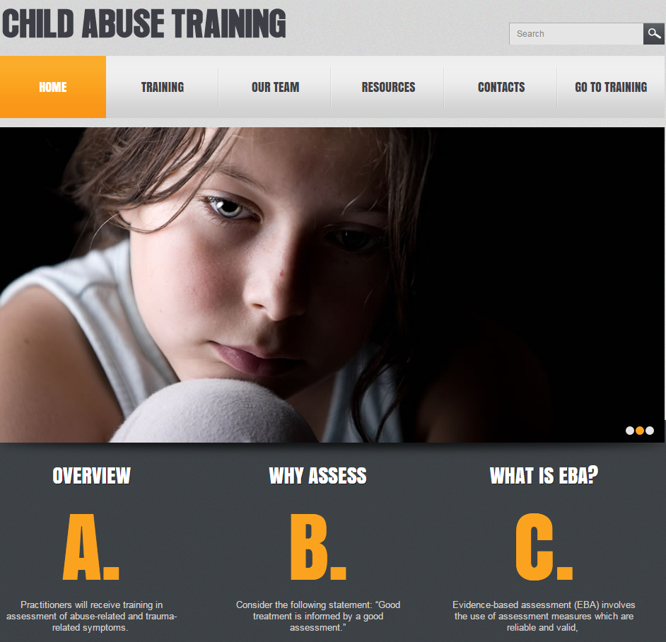
Preparing for the New NCA Standards on Mental Health Assessment: Best
Practices and Training
Jeffrey N. Wherry, Ph.D., ABPP
806.470.3342
jeffreynei@aol.com

Slide 2

2017 NCA Standards
Mental Health--C
Evidence-supported trauma-focused mental health services for the child client are consistently available and include:
  Trauma-specific assessment including traumatic events and abuse-
  related trauma symptoms,
  Use of standardized assessment measures initially to inform treatment,
  and periodically to assess progress and outcome,
  Individualized treatment plan based on assessments that are
  periodically re-assessed,
  Individualized evidence supported treatment appropriate for the child
  clients and other family members ,
  e. Child and caregiver engagement in treatment,
  f. Referral to other community services as needed.

Slide 3
Key points
Trauma-specific
Abuse-related (multiple dimensions: Depression/Trauma/Sexual Concerns/Anxiety/Anger)
Events and symptoms
Standardized measures to inform treatment
  Reliable( accuracy; consistency)
  Valid (measure the construct purported to measure)
  Normed (compared to a normative group)

Slide 4
Ratings of Instruments Used by
Community Clinicians Rated as Helpful
Percent Answered | Type of Assessment | Strongly Agree | Agree | Uncertain | Disagree | Strongly Disagree
58% | Intelligence test | 0.6% | 14.9% | 32.5% | 35.1% | 16.9%
61% | *Test of child depression | 17.9% | 58.0% | 20.4% | 3.7% | 0.0%
58% | Rorschach Inkblot Test | 0.0% | 1.9% | 40.4% | 32.1% | 25.6%
59% | Minnesota Multiphasic Personality Inventory for Adolescents | 1.9% | 34.2% | 50.3% | 8.4% | 5.2%
63% | Child Behavior Checklist OR Behavioral Assessment System for Children | 27.3% | 52.1% | 18.8% | 1.8% | 0.0%
64% | *Trauma Symptom Checklist for Young Children | 48.2% | 39.3% | 11.3% | 0.0% | 1.2%
58% | Bender Visual Motor Gestalt Test | 0.7% | 6.6% | 69.7% | 18.4% | 4.6%
63% | *Trauma Symptom Checklist for Children | 46.1% | 40.6% | 12.1% | 0.0% | 1.2%

Slide 5
Problem
Identification or “diagnosis” of sexual abuse in children is the initial step
Sexually abused children rarely are screened to assess for trauma-related symptoms using evidence-based assessments (reliable, valid, & normed)
Training &
Access to Services

Slide 6




Need
Training in evidence-based assessment (EBA) of abused children does not occur in most graduate and professional training programs across the nation.
Even in learning collaboratives designed to coach therapists in evidence-based treatments, assessment receives scant attention.
There is a need for abused children to have an assessment of abusive and traumatic events and their symptoms as reported by both child and parent.
This need is articulated in the new NCA Mental Health accreditation standard (effective 2017).

Slide 7
BIOLOGY of Trauma

Slide 8


Biology
Freeze
FLIGHT
FIGHT
Alarm

Slide 9
Alarm Reaction(PTSD)
Increase in sympathetic nervous system
↑Heart rate
↑Blood Pressure
↑Respiration
↑Released of stored sugar
↑Muscle Tone
↑Hypervigilance
↑Tuning out non-critical information

Slide 10
Stress Response (Dissociation)
Decreased blood pressure
Decreased heart rate
Endogenous opioids

Slide 11
Arousal + Dissociation
Arousal/PTSD
Dissociation

Slide 12

Common Signs and Symptoms
Recognition

Slide 13
Signs and Symptoms
Physical/Medical Indicators
  Enuresis
  Encopresis
  Abdominal pain
  Sexually transmitted diseases
  Recurring urinary tract infections
  Recurrent vaginal infections
  Pregnancy
  Conversion disorder or somatic complaints

Slide 14
Signs and Symptoms
Behavioral Indications
  Self-destructive/Suicidal behavior (34%)
  Sleep/Bedtime difficulties
  Sexual acting out—especially in preschool and adolescent children
  Fire setting
  Running away
  Concentration
  Eating disorders among adolescents
  Substance abuse
  Anger

Slide 15
Abuse Reactions
Trauma
PTSD
Dissociation
Sexualized response
Behavioral problems and negative affectivity
Anxiety
Depression
Anger

Slide 16
PTSD Criteria
Arousal (2) Re-Experiencing (1) Avoidant (3)
Sleep Recollections Thoughts/Feelings
Irritability Dreams Activities
Concentration Seems to Recur Memories
Hypervigilance Symbols Interests
Startle Others
Physiologic Affect
Future

Slide 17
PTSD Criteria—DSM-V
Arousal (2) Re-Experiencing (1) Avoidant (1)
Sleep Recollections Thoughts/Feelings
Irritability Dreams Activities (External)
Concentration Dissociative Cognitions/Moods(3/2)
flashbacks Dissociative amnesia
Hypervigilance Distress to symbols Negative self-expectations
Startle Physiologic Self-blame
Reckless or Pervasive horror, fear
self-destructive Interests
Detachment/Others
Restricted Affect
Future
See the work of Scheeringa,
Zeanah, & Cohen, 2010

Slide 20
DSM-IV Criteria for PTSD by DICA Parent Report*
Category Percent
Arousal 89%
Re-experiencing 84%
Avoidance 53%
Full Diagnosis 47%
*Pollio (2002): 57 sexually abused children

Slide 21
Misdiagnosis and Comorbidty:
A PTSD Formulation for Children
  AROUSAL
  RE-EXPERIENCING
  AVOIDANCE
PANIC/PHOBIA
ADHD
Bipolar
HALLUCINATIONS
SUBSTANCE ABUSE
DISSOCIATION
CONDUCT DISORDER
OPPOSITIONAL
PHOBIA
CONVERSION
SOMATIC
SEPARATION
ANXIETY/
OVERANXIOUS

Slide 22
Evidence-Based
Assessment
Treatment

Slide 23
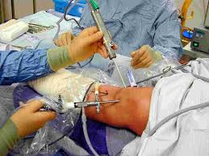
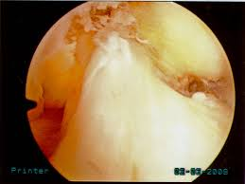
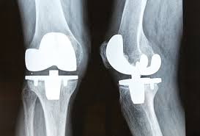
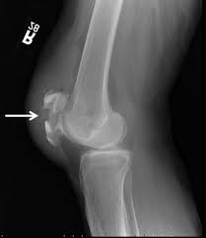
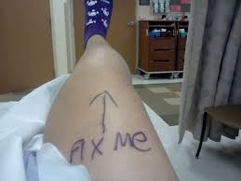

Why Assess? Let’s Start Treatment Now!
Knee Surgery

Slide 24
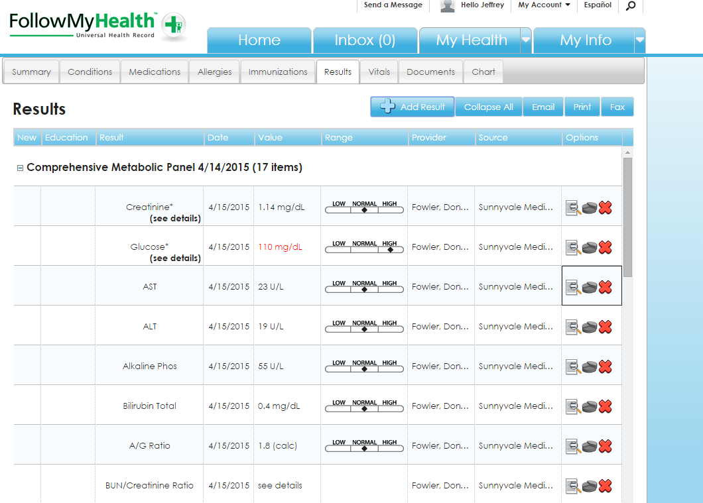
The importance of norming

Slide 25

The importance of norming

Slide 26
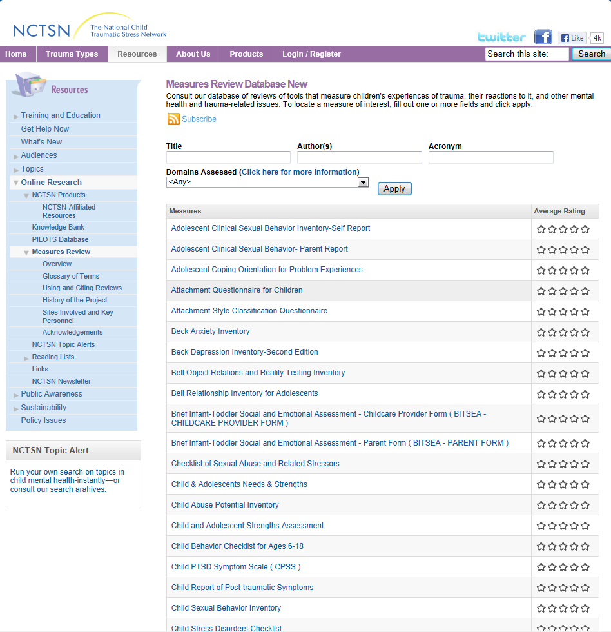

National Child Traumatic Stress Network http://www.nctsn.org/resources/online-research/measures-review

Slide 27
Best Practice vs. Evidence-Based Practice
Best Practice (activities)
  Not a specific practice
  A level of agreement about research-based knowledge and embedding the knowledge into delivery within the organization
  Best practice should be built on a foundation of Evidence-Based Practice (Driever, 2002)
  For the development of policies, procedures, and practices (EBPs)
  Developed by agencies, associations, and policy-makers and informed by alleged experts--consensus

Slide 28
Measures

Slide 29
California Evidence-based Clearinghouse for Child Welfare
Reliable
Valid
Sensitivity—correct identification of those with the symptom/condition
Specificity—correct identification of those without the symptom/condition

Slide 30
California Evidence-Based Clearinghouse for Child Welfare
Measurement Tools Highlighted on the CEBC
A basic description of each tool is available through the links below so that comparisons can be made between tools. Access/purchase and contact information is also provided. Please note that the list below reflects the measurement tools that the CEBC has reviewed to date and is not a comprehensive list of well-being measurement tools used in child welfare.
Tools Used for Screening Mental Health Needs
  Ages and Stages Questionnaire, Third Edition (ASQ-3™)
  Ages and Stages Questionnaire: Social-Emotional (ASQ:SE)
  Mental Health Screening Tool, The (MHST)
  Modified Checklist for Autism in Toddlers(M-CHAT)
  Modified Checklist for Autism in Toddlers, Revised, with Follow-Up (M-CHAT-R/F)
  Mood and Feelings Questionnaire (MFQ)
  Mood and Feelings Questionnaire-Short Form (MFQ-SF)
  Mood Disorder Questionnaire, The (MDQ)
  North Carolina Family Assessment Scale (NCFAS)
  Patient Health Questionnaire (PHQ-9) for Adolescents
  Pediatric Symptom Checklist-17 (PSC-17)
  Screen for Childhood Anxiety Related Emotional Disorders (SCARED)
  Strengths and Difficulties Questionnaire (SDQ)
(http://www.cebc4cw.org/assessment-tools/measurement-tools-highlighted-on-the-cebc/)

Slide 31
California Evidence-Based Clearinghouse for Child Welfare
Test | Abuse/ Trauma | Rel | Val | Sn/Sp | Norm | Par/Chi | Span | Cost
Ages and Stages Questionnaire | X (DevD) | + | + | + | + | x | +* | $
Ages and Stages Questionnaire: Social-Emotional (ASQ:SE) | X (DevD) | + | + | + | + | x | +* | $
Mental Health Screening Tool, The (MHST) | X(Risk) | x | x | x | x | x | x | 0
Modified Checklist for Autism in Toddlers(M-CHAT) | X (Aut) | + | x | + | x | x | x | 0
Modified Checklist for Autism in Toddlers, Rev, w/ Follow-up | X (Aut) | + | x | + | ? | x | x | 0
Mood and Feelings Questionnaire (MFQ) | X (Dep) | + | + | .80/.68 | x | + | +* | 0
Mood and Feelings Questionnaire-Short Form | X (Dep) | + | + | .75/.73 | x | + | +* | 0
Mood Disorder Questionnaire ADULT | X (Bip) | + | + | .73/.90 | x | x | +* | 0
North Carolina Family Assessment Scale FAMILY ENVIRON | X (Fam) | + | + | ? | x | x | +* | $
Patient Health Questionnaire (PHQ-9) for Adolescents | X (Dep) | + | + | + | x | Adol | x | 0
Pediatric Symptom Checklist-17 (PSC-17) | X (IEA) | + | + | X (.26) | x | x | +* | 0
Screen for Childhood Anxiety Related Emotional Disorders | X (Anx) | + | + | x | x | + | +* | 0
Strengths and Difficulties Questionnaire (I/E/A/Peer/Prosocial) | X (IEAPP) | + | + | x | x | P/S/T | Many* | $100/.20

Slide 32
NCTSN—Trauma Events
Traumatic Events Screening Inventory—C/P (TESI; structured interview)
Harborview Child and Adolescent Trauma Screen
Reaction Index

Slide 33
NCTSN Trauma Symptoms (No norms)
Child PTSD Symptom Scale
Child Report of Post-traumatic Symptoms
Children’s PTSD Inventory (structured clinical interview)
UCLA PTSD Reaction Index

Slide 34
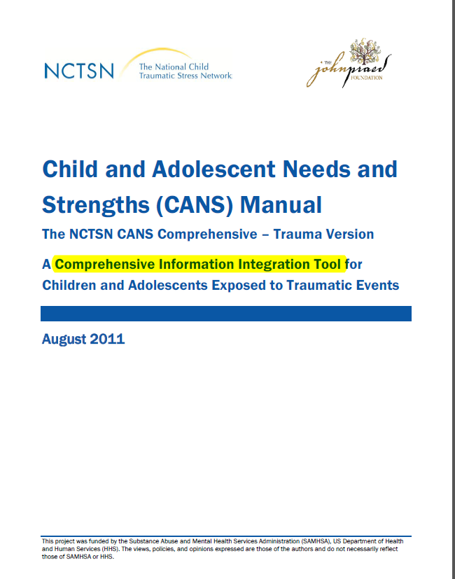
CANS: Child & Adolescent Needs and Strengths

Slide 35
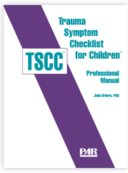
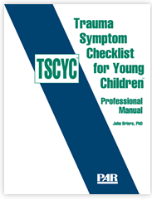
Multi-Dimensional Measures Recommended
Measure (age) | Dimensions | Administer | Rel/ Valid | Norms | Nature | Span- ish | Cost
TSCC (8-16) | Anx, Dep, Ang, PTS, Dis, Sex | Self | Yes | Yes | Empirical | +* | $3
TSCYC (3-12) | Anx, Dep, Ang, PTS, Dis, Sex | Caregiver | Yes | Yes | Empirical | +* | $3 (reuse x3)

Slide 36
TSCC/TSCYC Disadvantages
TSCC
TSCYC
Intrusive PTS primarily
10 PTS symptoms
Empirically derived (NOT diagnostic)
Non-overlapping ages
Length (54 items)
Cost
Sexual behavior
27 PTS (3 from each DSM-V cluster)
Empirically derived (NOT diagnostic)
Non-overlapping ages
Length (90 items)
Cost

Slide 37
Spaccarelli (1994)

Slide 38
Symptoms
Trauma Symptom Checklist for Children (& DCAC-SR)
Trauma Symptom Checklist for Young Children (& DCAC)
Child Sexual Behavior Inventory

Slide 39
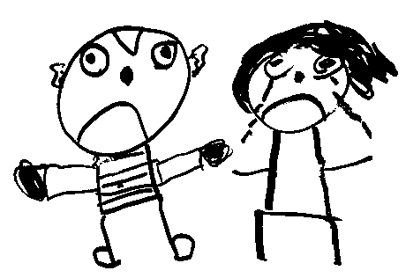
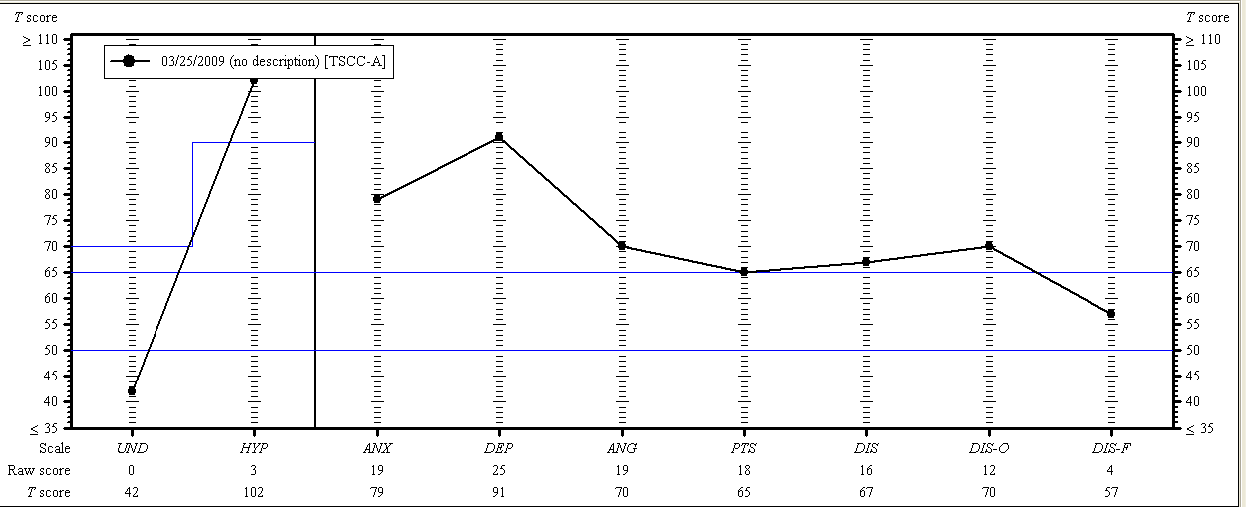
TSCC-A (9-year-old female DV)

Slide 40

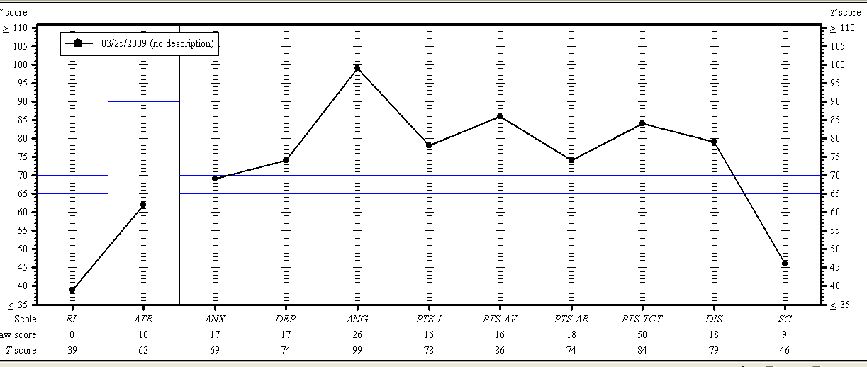
TSCYC (9 year old female DV)

Slide 41
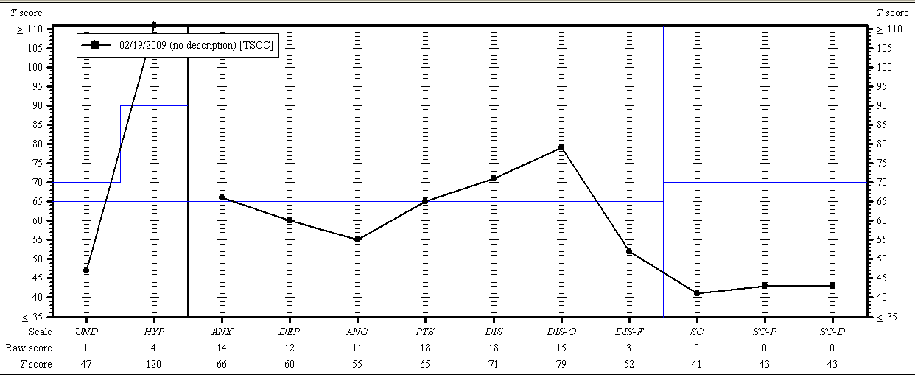
TSCC (9-year-old female; SA)

Slide 42
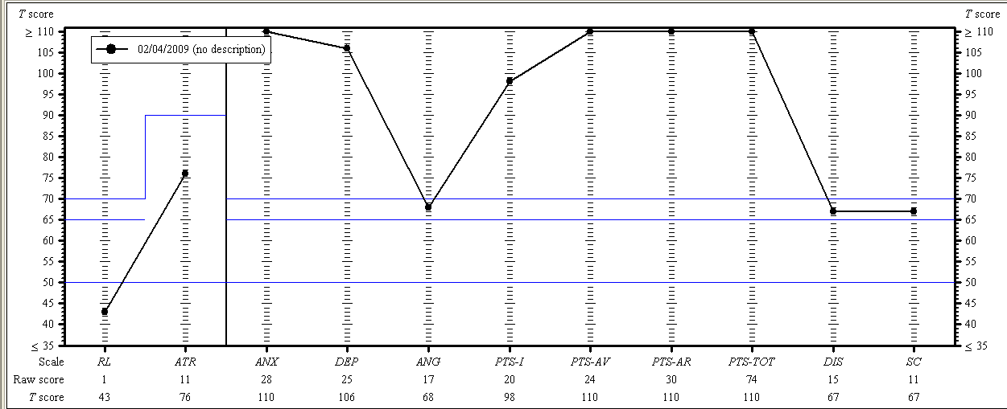
TSCYC (9-year-old female ;SA)

Slide 43
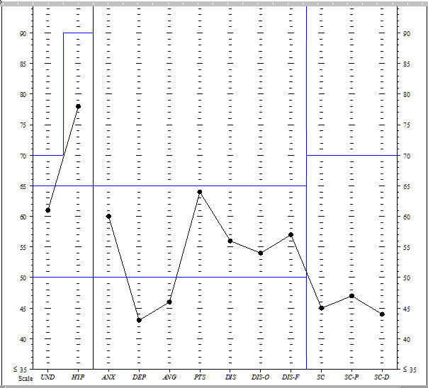
TSCC-age 10—PA, EA, possible SA, kidnapped

Slide 44
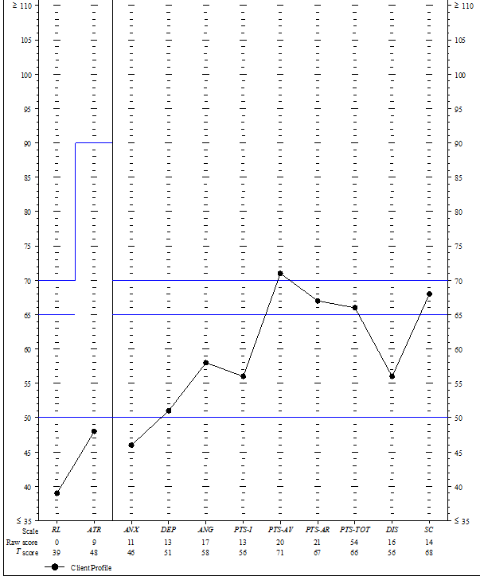
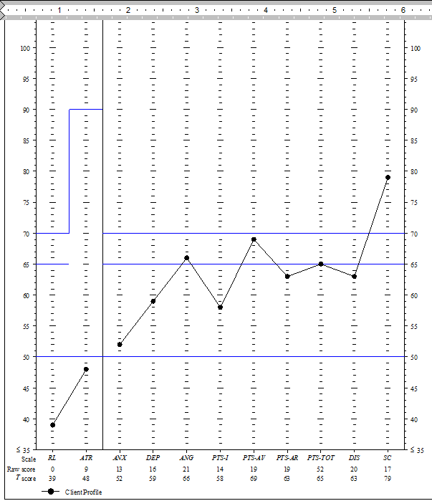
TSCYC (mom/dad)–age 10—PA, EA, possible SA; kidnapped

Slide 45
TSCC/TSCYC (child/mom)–age 10—PA,
EA, possible SA; kidnapped

Slide 46

Practical and Physical Needs
Spaccarelli (1994)
Family’s Response (Parent)
Parent Support Survey—Child, Parent, & Tx
Events in Life—Parent & Self-Report
Trauma Symptom Checklist for Children (& DCAC-SR)
Trauma Symptom Checklist for Young Children (& DCAC)
Child Sexual Behavior Inventory
Abuse Dimensions Inventory
Events Since Trauma
Events & Investigation

Slide 47
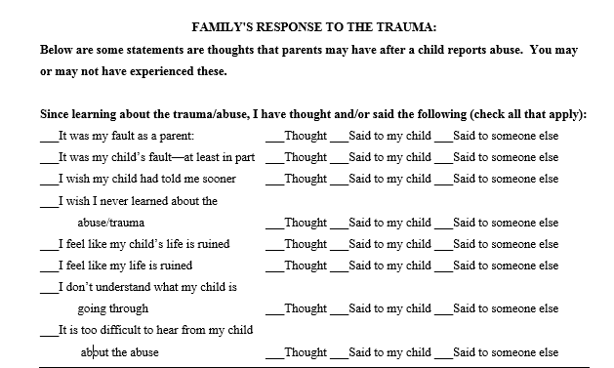
Family’s Response to Trauma

Slide 48
Training (Mississippi & Texas)

Slide 49
Background
Training combined synchronous (or interactive) learning and asynchronous learning (the use of web-based materials).
There were 9 hours of “instruction” distributed evenly (approximately 3 hours each) over 4 weeks (i.e., once every two weeks).
The first instruction session was in-person in Jackson, Mississippi. The remaining two 3-hour sessions were live videoconference presentations via Go-to-Meeting with real time opportunities for questions.

Slide 50
Background (Continued)
Content of the instruction included:
  Tests and Measurement
  Ethics
  Differential Diagnosis
  Assessing Polyvictimization
  Administration, Scoring, and Interpretation of the:
    Trauma Symptom Checklist for Children
    Trauma Symptom Checklist for Young Children
    Child Sexual Behavior Inventory
  Matching Symptoms with Evidence-based Treatments
Add
New PAR Screening Measures

Slide 51
Background (Continued)
Clinician/Learners were required to administer assessments to three children/families.
  Those data were reviewed by the instructor with the individual learner, and together the cases were presented to the entire learning cohort, so that every learner might learn from the cases presented.
A proficiency test was self-administered online, and a score of 80% correct was required of all learners.
Clinician/Learners also collected measurement data on individual clients and reported on the therapy approach used with clients
  This portion of the evaluation was initiated by the Mississippi State CAC chapter

Slide 52
DCAC Data

Slide 53
Clinical Symptoms Associated with
Abuse/Trauma Symptoms (% clinical)
Trauma Symptom Checklist for Child (Self-Report)
Trauma Symptom Checklist for Young Children (Caregiver Report of Child)
PTSD (12%)
Dissociation (13%)
Sexualized Behavior (16%)
Anger (5%)
Depression (8%)*
Anxiety (13%)
PTSD (42%)
Dissociation (26%)
Sexualized Behavior (23%)
Anger (23%)
Depression (26%)*
Anxiety (31%)
*Approximately 44% of our children have thoughts of killing/hurting self

Slide 54
Reduction in Symptoms for All Children Self-Report (All significant)

Slide 55
Reduction in Symptoms for Self-Report With Clinically Elevated Scales—All Significant

Slide 56
Reduction in Caregiver Reported Symptoms for All Children –All Non-Significant

Slide 57
Reduction in Caregiver Reported Symptoms for Clinically Elevated Children –All Significant

Slide 58
Lessons Learned from Data

Slide 59
Lessons Learned
Learners should be encouraged to count the cost before committing to a demanding 9-month training.
  The consultation/supervision phase is where the real learning, correction, and integration of knowledge occurs. (like a graduate school practicum placement)
  The high dropout rate (56%) may also indicate the need for closer oversight by Executive Directors and/or greater incentives for learners/employees.
The proficiency exam is meaningful and relevant inasmuch as no one made a 100 and all who attempted ultimately passed with a score of 80% or above (by the second attempt). However, 40% of learners did not pass their first attempt.

Slide 60
Helpful Resources

Slide 61
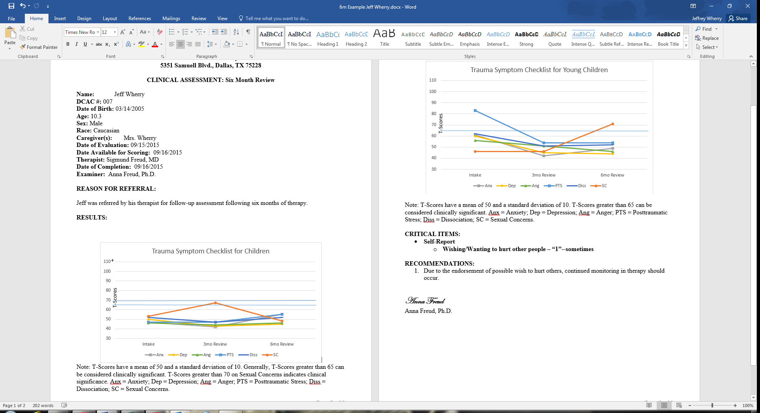
Re-Assessment with TSCC/TSCYC

Slide 64
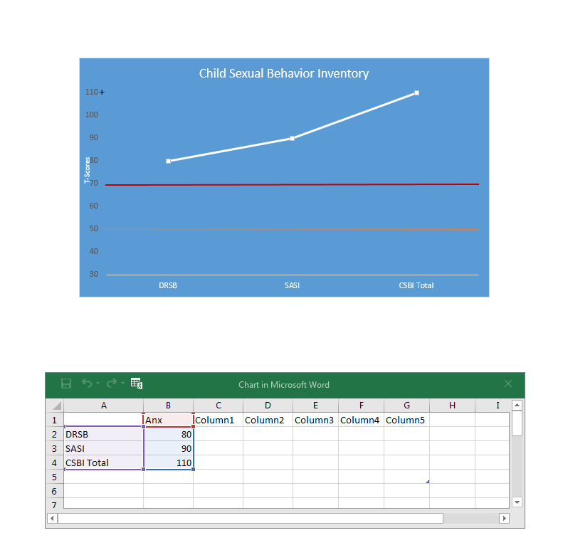
Graphing the CSBI

