Slide 1
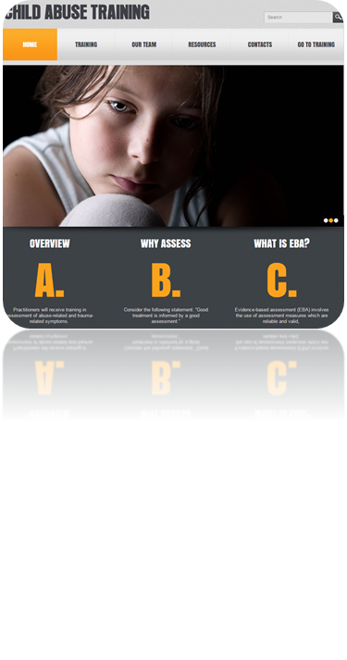
NCA Standards for Family Advocacy:
The Family Advocate Role as One Remedy/Response to Engagement
Jeffrey N. Wherry, Ph.D., ABPP
806.470.3342
jeffreynei@aol.com

Slide 2
Learning Objectives
Review information on dynamics of abuse, trauma-informed services, crisis intervention, and risk assessment
Discuss strategies using this knowledge to strengthen relationships with families, engage parents in treatment, and to support families.
Discuss myths (e.g., allegations in disputed custody) and misunderstandings (e.g., the medical exam as the “litmus test) to address with families to facilitate their belief and support

Slide 3
NCA Standards (2017)
Training
  a. Dynamics of abuse,
  b. Trauma-informed services,
  c. Crisis assessment and intervention,
  d. Risk assessment and safety planning,
  e. Professional ethics and boundaries,
  f. Understanding the coordinated multidisciplinary response,
  g. Assistance in accessing/obtaining victims’ rights as outlined by law,
  h. Court education, support and accompaniment.
  i. Assistance with access to treatment and other services, including protective orders, housing, public assistance, domestic violence intervention, transportation, financial assistance, interpreters, among others as determined for individual clients.

Slide 4
NCA Standards (2017)
Training
  a. Dynamics of abuse,
  b. Trauma-informed services,
  c. Crisis assessment and intervention,
  d. Risk assessment and safety planning,
  e. Professional ethics and boundaries,
  f. Understanding the coordinated multidisciplinary response,
  g. Assistance in accessing/obtaining victims’ rights as outlined by law,
  h. Court education, support and accompaniment.
  i. Assistance with access to treatment and other services, including protective orders, housing, public assistance, domestic violence intervention, transportation, financial assistance, interpreters, among others as determined for individual clients.

Slide 5
NCA Standards (2017)
Services
  Crisis assessment and intervention, risk assessment and safety planning and support for children and family members at all stages of involvement with CAC,
  Assessment of individual needs, cultural considerations for child/family and ensure those needs are addressed,
  Presence at CAC during the forensic interview in order to participate in information sharing, inform and support family about the coordinated, multidisciplinary response, and assess needs of child and non-offending caregiver,
  Provision of education and access to victim’s rights and crime victim’s compensation,
  Assistance in procuring concrete services (housing, protective orders, domestic violence intervention, food, transportation, public assistance etc.),
  Provision of referrals for trauma focused, evidence -supported mental health and specialized medical treatment, if not provided at the CAC.
  Access to transportation to interviews, court, treatment and other case-related meetings,
  Engagement in the child’s/family’s response regarding participation in the investigation/prosecution,
  Participation in case review to: communicate and discuss the unique needs of the child and family and associated support services planning; ensure the seamless coordination of services; and, ensure the child and family’s concerns are heard and addressed,
  Provision of updates to the family on case status, continuances, dispositions, sentencing, inmate status notification (including offender release from custody),
  Provision of court education & courthouse/courtroom tours, support, and court accompaniment.
  Coordinated case management meetings with any and all individuals providing victim advocacy services.

Slide 6
A word about trauma
Not all abuse is traumatic
  Some children are sexualized
Not all trauma results in PTSD

Slide 7
NCA Standards (2017)
Services
  Crisis assessment and intervention, risk assessment and safety planning and support for children and family members at all stages of involvement with CAC,
  Assessment of individual needs, cultural considerations for child/family and ensure those needs are addressed,
  Presence at CAC during the forensic interview in order to participate in information sharing, inform and support family about the coordinated, multidisciplinary response, and assess needs of child and non-offending caregiver,
  Provision of referrals for trauma focused, evidence -supported mental health and specialized medical treatment, if not provided at the CAC.
  Engagement in the child’s/family’s response regarding participation in the investigation/prosecution,

Slide 8
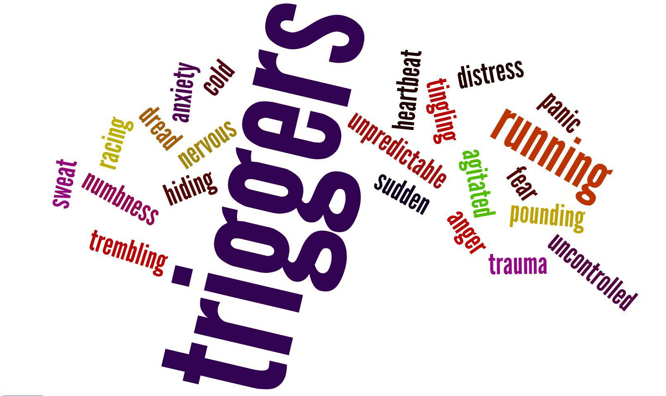
Dynamics about child abuse
Sexual abuse
  Secrecy
  Sexualization
  Shame
  Sides
Physical abuse
  Punishment
  Power
  Psychoeducation

Slide 9

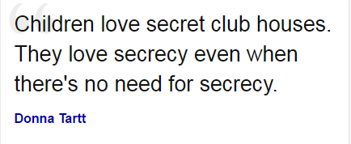
Secrecy
Malign something “sweet”
and developmentally appropriate into something twisted and dark

Slide 10

Secrecy
No secrets
  Confidentiality is not about unfettered secrecy, but rather a clear communication about the limits of confidentiality
Shining light on the darkness
Talking sensitively, but directly aids in the gradual exposure of children who have been traumatized
  Secrecy gradually introduces trauma
  Gradual exposure, in vivo exposure, & systematic desensitization minimize the impact of trauma

Slide 11
Sexualization
Sexualized play, comments, drawings are not pathognomonic for abuse
Consider alternative explanations
  Media (movies, television, smartphones & computers)
  Observed behavior (parents, babysitter)
  Normal sex play

Slide 12
Sexualization
Identify problem behavior and address it (regardless of the source)
  There are times when sexualized behavior is more urgent than other important issues like trauma

Slide 13
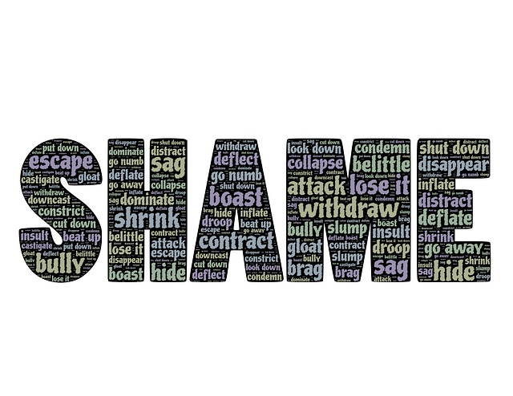
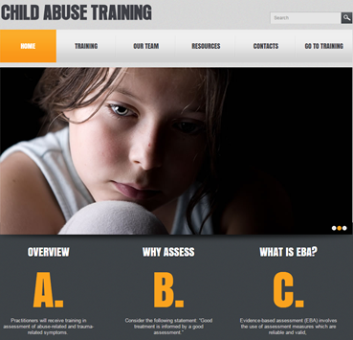

Shame
Shame about the whole self
Common
Leads to depression
  Suicidality
Not addressed through platitudes
Good Will Hunting

Slide 14
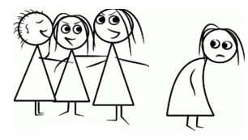
Sides
Taking sides among family members

Slide 15
Physical Abuse
Punishment
Power
Psychoeducation

Slide 16
Physical Abuse
Punishment
  The use of punishment is not necessarily a bad thing
  Overuse, extreme punishment, or no other technique used renders punishment ineffective and likely to escalate
  Not a good option for parents with affective control problems
Power
Psychoeducation

Slide 17
Physical Abuse
Punishment
Power
  Evil, sick people who enjoy hurting others
Psychoeducation

Slide 18
Physical Abuse
Punishment
Power
Psychoeducation
  Parents who lack skills
    Skills must be taught , coached, demonstrated
  Parents without knowledge (e.g., appropriate developmental milestones for things like bedwetting)
  Parents with unrealistic expectations who are impervious to the presentation of information
    Motivational interviewing

Slide 19

Trauma Informed Services
http://cv.musc.edu/
Overview of Child Victimization
Psychological and Behavioral Impact
Social and Health Consequences
Criminal Justice and Child Advocacy
Assessment Strategies
Evidence-Based Treatment Planning
Case Management Skills for Treatment Success
Evidence-Supported Treatments

Slide 20
Trauma Informed Services:
Other topics of importance
ACEs and its implications
PTSD and other trauma reactions and their misdiagnosis
Myths and misinformation (to be covered later)
Common parental responses and how to “make it right”

Slide 21
Risk Assessment & Crisis Intervention
Risks
  Re-abuse
  Domestic violence
  Other co-morbid forms of child abuse
  Taking sides within families
  Seeing children in therapy when they are not safe (“someone needs to monitor them in therapy)
  Perceived safety issues
  Talking with parents about
    Sharing too much information (case, financials, etc.)
    Monitoring movie habits
  Suicidality and self-harm
Assess & Refer
  Intensify services
  More frequent services
  Inpatient hospitalization

Slide 22
Services (Massat & Lundy, 1999)
Helpful
Received
Food
School supplies
Clothing
Housing
After school program
Medical care
Child care
Support/Therapy/Parent
Training
Advocacy
Legal aid
Psychiatric
Homemaker
Psychiatric
Medical care
Advocacy
Support/Therapy/Parent
Food
Legal aid
Child care
Clothing
Training
School supplies
Housing
After school program
Homemaker

Slide 23
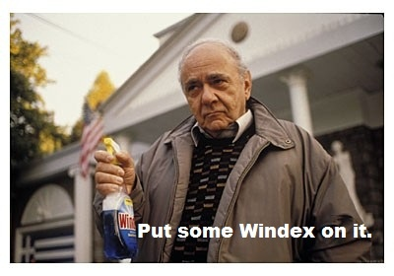
Engagement
Reducing traditional barriers
  Finance (gas cards, cab service, etc.)
  Transportation (urban and rural)
    Develop alternative delivery options (PCIT via IPad)
  Child care
  Snacks
  Stigma—explaining symptoms and treatment
    Because everyone has an expert in their social network
      Gall bladder
    Fears of being “crazy” due to unusual symptoms
  Adequate space (no halls)
  Referrals
    Names
    Warm hand-off
  Misunderstandings about the mystical nature of treatment

Slide 24


Less well-understood barriers in the world of CACs
Confusion about CAC staff roles among family members
  Investigation?
  CPS?
  Law enforcement?
Comprehensive “wraparound services” (i.e., systems of care)
  Ft. Bragg Study—More is not better; better is better

Slide 25
Less well-understood barriers in the world of CACs
One stop shopping, co-location, meet all needs
  How about the single parent who returns for an appointment after the forensic interview—arguably the worst day in their life—and they feel nauseous as they pull up to your building
    How often does that happen
    We don’t know because we do not ask
Participation in the decision to pursue treatment and consideration given to the pros and cons (motivational interviewing)
Engagement through assessment and feedback
Being empathic and genuine
In the course of being helpful, find time for appropriate humor
  Consider self-deprecating humor

Slide 26
As parents go,
so go the children

Slide 27
Parent Involvement in Therapy
Based on Age of the Child

Slide 28
Initial Impact on Parents
Nature of the event
  Unexpected
  Confusing
Many experience a sense of
  Disbelief
  Denial
Much like death
or cancer of child
This is the
worst day
of their life

Slide 29

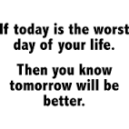



Slide 30
Why, Apart from the
Abuse Itself, Is This a Crisis?
How could I have been fooled?
What kind of dupe am I?

Slide 31

Is it realistic for a spouse or significant other to believe immediately?

Slide 32

For parents, it is important to convey a believing attitude toward the child….as they struggle to resolve some of their disbelief and ambivalence

Slide 33

This stance, it seems, is necessary to support the child

Slide 34
Caregivers must be free to pursue their doubt, anger, and hurt with another adult…otherwise?

Slide 35
Disclosure, Recantation, and “False Allegations”

Slide 36



Disclosure

Slide 37

Disclosure
(Sorensen & Snow, 1991)
116 cases of CSA – substantiated by compelling evidence
Most disclosures were accidental (74%)
For those that did disclose
  22% recanted
  Of the 22%, 92% reaffirmed

Slide 38
Other Studies on Recantation
(4-33%)
CPS Cases
  Bradley and Wood (1996) 4%
  Crewdson (1998) 12%
  Faller (1998) 33%
  Jones and McGraw (1987) 8%
Treatment Cases
  Gonzalez et al. (1993) 27%

Slide 39
Delays in Reporting Do Not
Nullify the Validity of the Allegation
Smith et al. (2000) found that about half of rape victims raped at a mean age of 10, did not tell within the first year
A majority of girls did not disclose to a trained interviewer even when there was unequivocal evidence (STD) (Lawson & Chaffin, 1992)

Slide 40
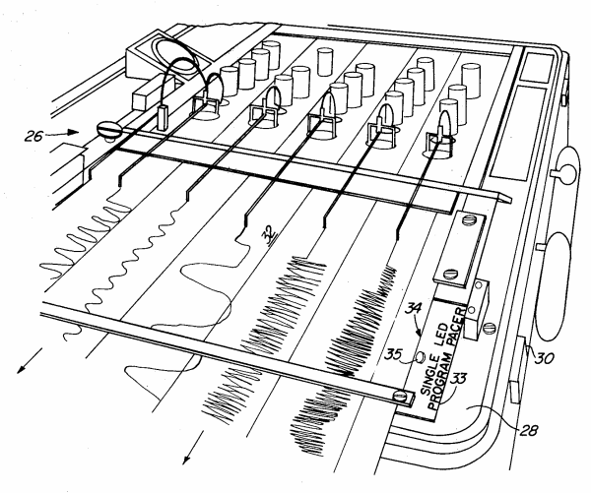
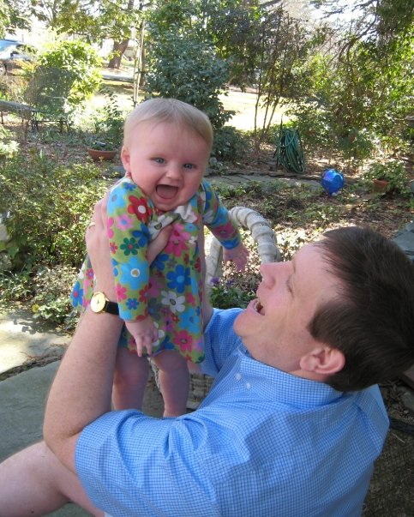

Disputed Custody and Sexual Abuse Allegations

Slide 41
Issue of Empirical Studies
This is particularly relevant to the extant literature related to allegations of SA in custody and visitation/access cases

Slide 42
Criteria for Un-Acceptability as Empirical
Book published by own company
Book published by any company (no review of assertions)
Peer-reviewed journal vs. non peer-reviewed
Clinical Cases vs. Studies
  Qualitative vs. Quantitative
  Small sample vs. large sample
    Issue of power
Samples:
  Actual vs. Analog (memory and suggestibility)
  Biased sampling
    All cases/Random
    A subset of cases

Slide 43


Studies involving strictly problematic cases
Author (Year) | Sample Size | % of False Allegations
Green (1986) | 11 | 36% fabricated
Benedek & Schetky (1985) | 18 | 55% unable to document
Jones & Seig (1988) | 20 | 20% were fictitious

Slide 44
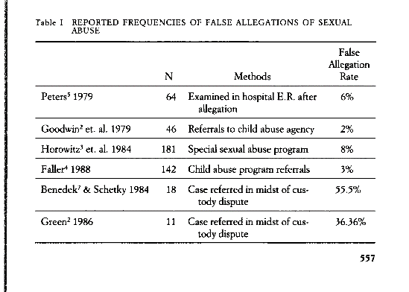
False Allegations (Early “Studies”)
(Mikkelesen et al., 1992)

Slide 45
Unsubstantiated & Intentionally
False
Third National Incidence Study (NIS-3; King et al., 2003)
  60% of cases were unsubstantiated
  .02% of SA cases in five states were intentionally false
Canadian Incidence Study—1998 (CIS-98; Trocmé et al., 2001)
  33% of cases were unsubstantiated
  4% of all abuse cases were intentionally false

Slide 46
Other Studies of
Child Protective Cases
Author(Year) | Location | Sample Size | % of Intentionally False Allegations
Oates et al. (2000) | Australia | 551 of SA | 2.5%
Trocmé et al. (1994) | Ontario | 2,447 child abuse & neglect | 2.5%
Jones & McGraw (1987) | U.S. | 576 of SA | 6%
Anthony & Watkins (1991) | U.K. | 350 of SA | 8.5%

Slide 47
Author(Year) | Location | Sample Size | % of Intentionally False Allegations
Trocmé & Bala (2005) | Canada | 7,672 abuse cases (67% substantiated) | 4% of abuse 6% of SA 12% of those with custody/access at issue
.02-12%

Slide 48
Court Cases
Author(Year) | Location | Sample Size | % of intentionally false allegations
Thoennes & Tjaden (1990) | U.S. | court cases | 2% alleged SA .3% were intentionally false
Noncustodial parent was more likely to make a false allegation than the custodial parent.

Slide 49
Why Might Children Make
Allegations of Abuse?
Allegation is not true
  Coached by a vindictive, desperate parent
  A question or concern becomes an investigation because of unqualified questioning
Allegation is true, but not enough detail to substantiate
Allegation is true
  The abuse leads to the divorce
  The child is safe to make the allegation
  Where DV, the parent is safe to support the allegation

Slide 50
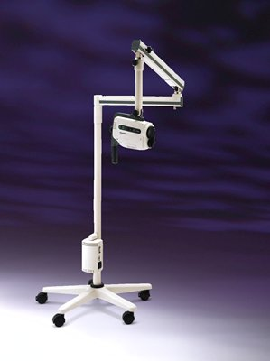

Medical Findings

Slide 51
Medical Findings
Author(year) | Dubowitz (1992) | Adams (1994) | Kellogg (1998) | Pugno (1999) | Berenson (2000) | Heger et al. (2002)
Number | 99 | 236 | 157 | 1,058 | 192 | 2,384
Vaginal Normal /nonspecific | 62% | 77% | 85% | 64.7% | 97.5% | 96.3%
Suspicious /Suggestive | 10% | 9% | 12%
Definitive | 28% | 14% | 3%
Anal Normal /nonspecific | 65% | 93% | 100% |  |  | 96.3%
Suspicious /Suggestive | 35% | 7% | 0%

Slide 52
Distress in Parents
PTSD
  Mothers experience more intrusive and avoidant symptoms than fathers (Kelley, 1990)
  More at risk if children testify in court (Kelley, 1990)
Depression
  High in mothers (46%), as well as fathers (22%) (Davies, 1995)
  Not higher though than mothers of an outpatient sample of non-abused children
Forgotten Fathers

Slide 53
Symptoms
Trauma Symptom Checklist for Children (& DCAC-SR)
Trauma Symptom Checklist for Young Children (& DCAC)
Child Sexual Behavior Inventory

Slide 54
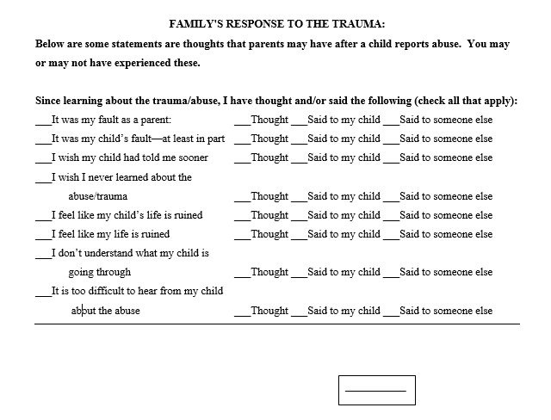
Family’s Response to Trauma

Slide 55
EBTs for Trauma
Trauma Focused Cognitive Behavioral Therapy (Mannarino, Deblinger, & Cohen)
Eye Movement Desensitization Reprocessing (Shapiro)
Prolonged Exposure for Adolescents
Child-Parent Psychotherapy
Problematic Sexual Behavior--A Cognitive Behavioral Approach (Silovsky)
Outpatient

Slide 56
TF-CBT- Core Components
PSYCHOEDUCATION: Providing education to children and their caregivers about the impact of trauma on children and common childhood reactions to trauma
STRESS MANAGEMENT: Developing personalized stress management skills for children and parents
AFFECTIVE EXPRESSION & MODULATION: Helping children and parents identify and cope with a range of emotions
COGNITIVE COPING: Teaching children and parents how to recognize the connections between thoughts, feelings and behaviors

Slide 57
TF-CBT Core Components
CREATING THE TRAUMA NARRATIVE: Encouraging children to share their traumatic experiences either verbally, in the form of a written narrative, or in some other developmentally appropriate manner.
COGNITIVE PROCESSING: Modifying children's and parents' inaccurate or unhelpful trauma-related thoughts, and
BEHAVIOR MANAGEMENT TRAINING: Helping parents develop skills for optimizing their children's emotional and behavioral adjustment
PARENT CHILD SESSIONS: Helping children and parents talk with each other about the traumatic experiences

